Slide 1
Notes:
How Gay Marriage Affected you:
Mark Will not perform marriage without it gay marriage legal
Talk about Jude with Lauren and Cristie
How can a women on drugs be more capable of razing a child then a couple who loves each other
There appears to be two sides:
“Liberal Left” – supports marriage equality
“Religious Right” – supports Strong morals
And we are deeply deadlocked according to a 2009 Gallup Poll

Slide 2
Notes:
Only 1,015 adults, aged 18 and older, were surveyed. In a country with 311, million people that is a small smaple

Slide 3
Notes:
Turned to State Amendments:
Proposition 8 in 2008 was the most popular: 52% for 48% 7,001,084 For 6,401,482 Against
Alaska Ballot Measure 2, Joint Resolution 42
Nevada Nevada Question No. 2
Mississippi Mississippi Amendment 1
Missouri Constitutional Amendment 2
Montana Montana Initiative 96
Oregon Oregon Ballot Measure 36
Colorado Colorado Amendment 43
Tennessee Tennessee Amendment 1
Arizona Arizona Proposition 102
In most states with the exception of Mississippi and Tennessee, fall within 50-60% approval in each states government.
There appears to be two sides:
“Liberal Left”
“Religious Right”
For the Right:
Leviticus 18:22 in “The World English Bible” states:

Slide 4
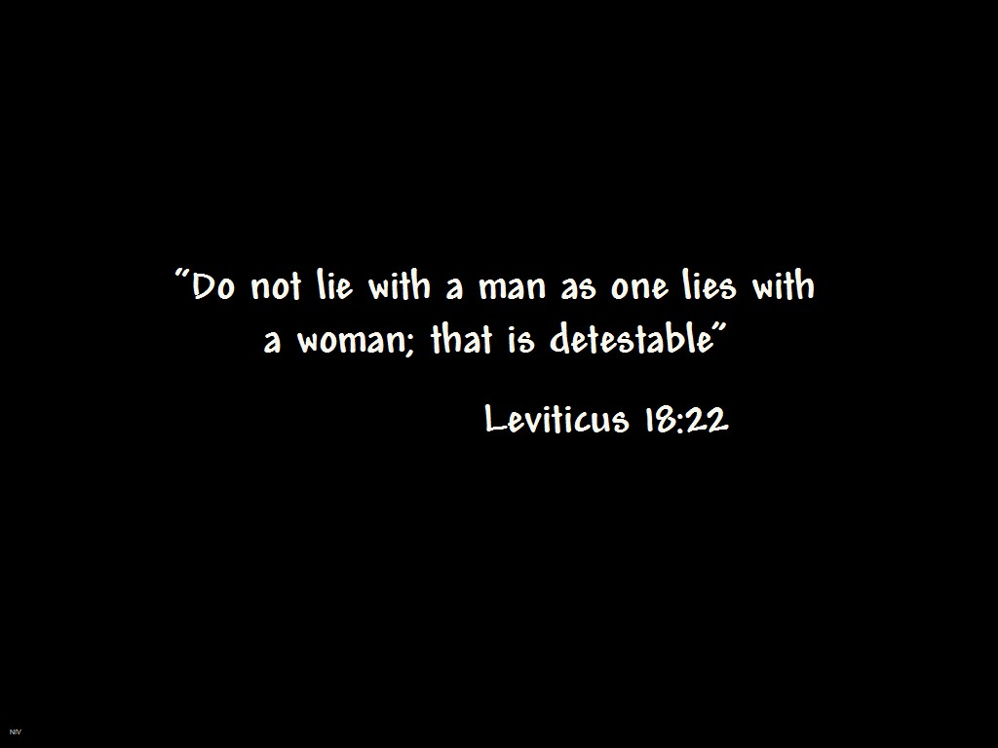
Notes:
This quote is a favorite of the GOP and is used to point out that homosexuality is a sin

Slide 5
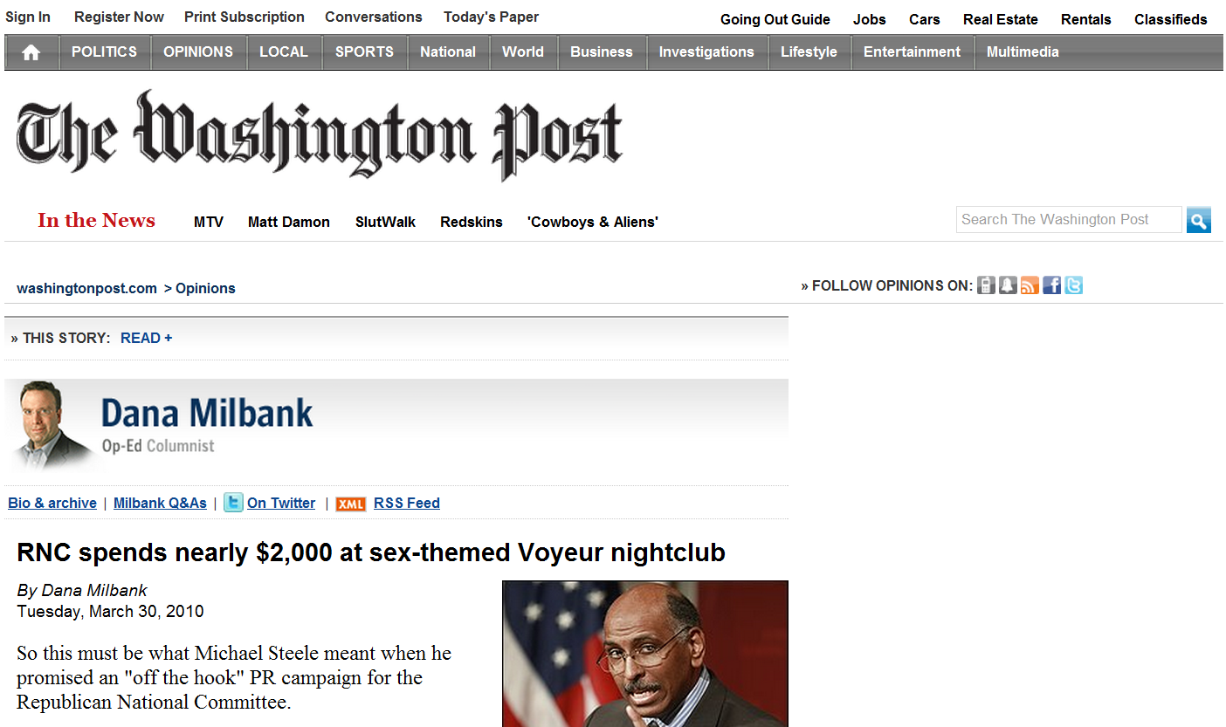
Notes:
Except in the case where it is lesbian voyeurism

Slide 6
Notes:
Other arguments:
Scientifically, marriage between a male and a female is the natural order of life.
The natural difference between man and woman, including sexual differences,
is what draws them together and forms the basis of their relationship. Without those differences, a committed relationship can not occur. [With reports of divorce rates at around 50% (according to the NY Times) how can we be sure of that with no study]
Many religious figures view homosexuality as a sin and therefore any union based on such a relationship is also deemed sinful. Then we cannot honor this stand according to the constitution.
I respect these beliefs because I believe (as Mark did with his stance on performing straight marriages) that we need to stand up for our beliefs. Both sides mock each other.
At the 2008 Comic Con with WBC (a firm anti gay organization) protested all the nerds because they worshiped false idols. How did they respond

Slide 7
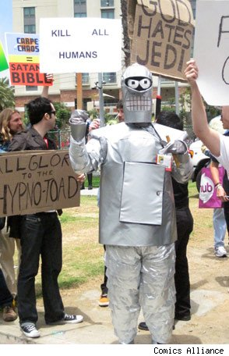
Notes:
By mocking their protest.

Slide 8
Notes:
Arguments for Gay marriage:
The right to marry is a fundemental right protected by the United States Constitution.
<do no see it any ware>
Without the legal right to marriage, same sex couples lose their right to health care coverage, family leave, child custody protections, tax protections, inheritance protections, and pension plan options.
<talk about you and marisas health care>
Permitting legal same sex marriages will not force any religion to perform such ceremonies against their beliefs, doctrine, or morals.
<talk about ADA Lawsuits>

Slide 9
Notes:
Why do we do this
Get rid of Marriage in the government. Treat it as LLC
Alan M. Dershowitz of Harvard came up with the idea
Makes pre-nups easier
Assets clearly divided all that remains is child custody

